Slide 1
US Police Shooting
Exploratory Data Analysis by Enkhchimeg Tsendnyam
August 2020

Slide 2
Background on the dataset:
The dataset is on US police shootings data from 2015 to June 2020. “The dataset contains basic data about people like their name, age, gender and race. Along with it, is the shooting/killing information, such as the date of event, where it happened? How they were shot? Did they attack? Were they holding weapons? Did they show any mental illness? Was the policeman wearing a camera/was the incident recorded? Did the suspect flee? Apart from that, a category column holds type of weapon used by the suspect.”

Slide 3
Statistical questions:
Are black and brown, likely to get killed by police?
What is the average age of the people that were killed by police?
Which city and state had the highest number of shootings by police?
What percentage of the people showed signs of mental health illnesses?
Does variables such as sign of mental illness, year, age have an impact on the type of arms that were used?

Slide 4
For the explorations in this project, I will use the following variables:
id is the integer id of the suspect
date is the integer day/month/year of the killing
race is the object race of the suspect
state is the object state of the incident
signs_of_mental_illness is the boolean sign of the mental state of the suspect
threat_level is the object threat level of the suspect
flee is the object of whether deceased fleed or not prior to the death
body_camera is the object body camera of the police who killed the suspect
arms_category is the object type of weapon used by the suspect

Slide 5
Histograms:
Due most of the variables used for histograms being “objective” type data, there is no outliers or extreme values that might be errors.

Slide 6
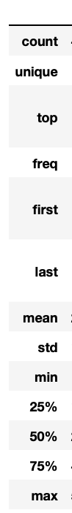
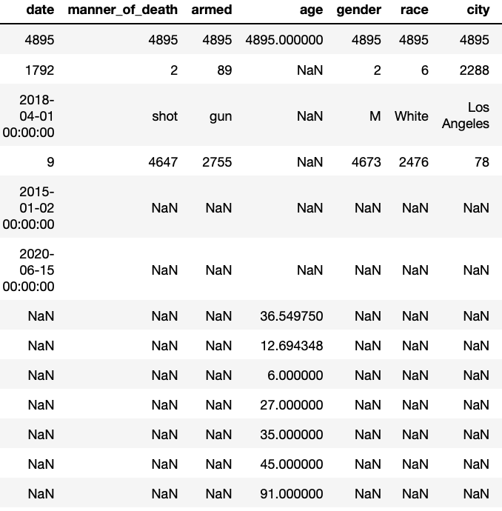
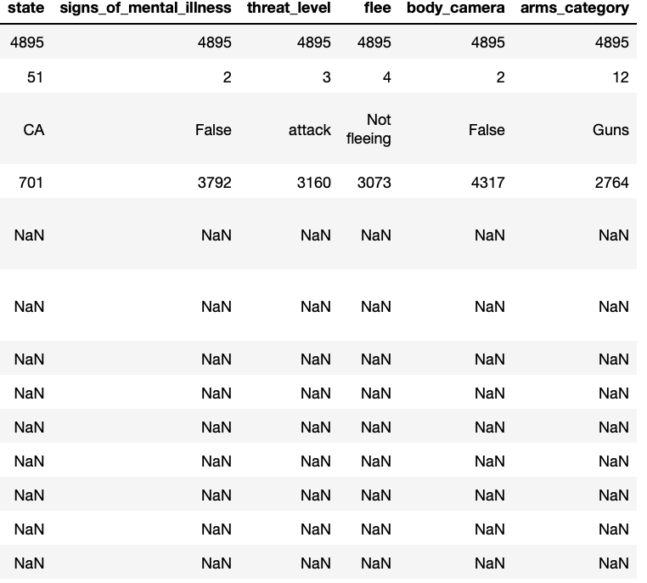
Descriptive Statistics

Slide 7
PMF
Gun ---
Other ---

Slide 8
CDF

Slide 9
Relationships: Scatter Plots
Age & Year
Arms Category & Year

Slide 10
Correlation & Causation

Slide 11
Conclusion
Outcome of your EDA
1. According to the US Census Bureau, in 2019, US population id composed of 63% of White, 15% of Hispanic, 13% of Black, 6% of Asian, 1% of Native, 2% of other. If the police killings in our dataset were directly proportion to the race, we would see somewhat close to numbers shown below in reality:
White – Expectation: 3083 (63%) ; Reality – 2476 (51%)
Hispanic – Expectation: 734 (15%); Reality – 902 (18%)
Black – Expectation: 636 (13%); Reality – 1298 (27%)
Asian – Expectation: 293 (6%); Reality – 93 (2%)
Native - Expectation: 49 (1%); Reality – 78 (2%)
Other – Expectation: 98 (2%); Reality – 48 (1%)
Total – Expectation: 4895
Even though Black and Native American people take up 13 and 1 percent of the US population respectively, they represented double their ratio when it comes to police shootings victims. On the other hand, White and Asian people take up 63 and 6 percent of the US population respectively, they only represented 51 and 2 percent of the victims in our data. Just based on the mere ratio, we can easily tell black and brown people are more likely to become a victim of police shootings.
2. As we have seen through summary statistics, the average age of the police shootings victims were 36 years old. The youngest one was 6 while the oldest one was 91. We can say the youngest and oldest are the outliers, but it definitely happens as we have all seen through past media coverings on police shootings.
3. Los Angeles, California had the highest number of police shootings total of 701.
4. Only 23% of the police shooting victims showed signs of mental illness, 77 percent did not show any sign
5. When we looked at arms used by the victims and the year, guns and sharp objects were consistent throughout the last 5 year. However, the number of cars that are used by the victims have increased since 2018. Through our correlation matrix, there was no significant correlations found between any of the variables.
What do you feel was missed during the analysis?
I did not realize how difficult my dataset were going to be when it comes to some of the complex questions such as hypothesis test and regression. The dataset itself simply lacked quantitative variables that it was impossible to answer the hypothesis test and regression. I guess I could have manipulated the date more, but even I would not even know where to start to manipulate. I had many categorical variables that were nice to be used for histogram frequency visualization purposes.

Slide 12
Conclusion
Were there any variables you felt could have helped in the analysis?
I think if the date column was in right format it could have helped with a hypothesis testing. I tried to manipulate the the date, by separating, the month, year and doing many other things, I still could not figure out the way to the hypothesis testing.
Were there any assumptions made you felt were incorrect?
Most of my assumptions were correct. Before I started the analysis, I had an assumption sign of mental health illness or age could have an impact on variables such as threat level, arms and manners of death. Through my correlation matrix as well as through number of scatter plots I tried, I could not find any evidence of that.
What challenges did you face, what did you not fully understand?
I think my biggest challenge was not having enough quantitative variables in my data. I only had age and case is as integers. But case id had nothing to do with anything. So I could say, I had 1 quantitative variable and everything else were categorical. I still have no idea how to do a hypothesis test and regression analysis on a dataset with only one quantitative variables. Those two areas will be my improvement areas for my self-learning.

